Slide 1
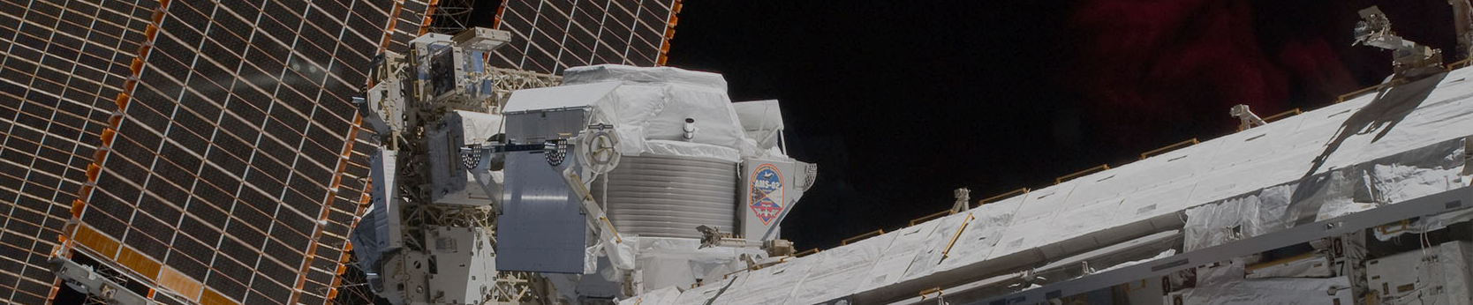

Summary
Test text line1
Test text line2
Test text line3
……
For more details about our detector, analysis, and physics results
please visit:
https://AMS02.space

Slide 2
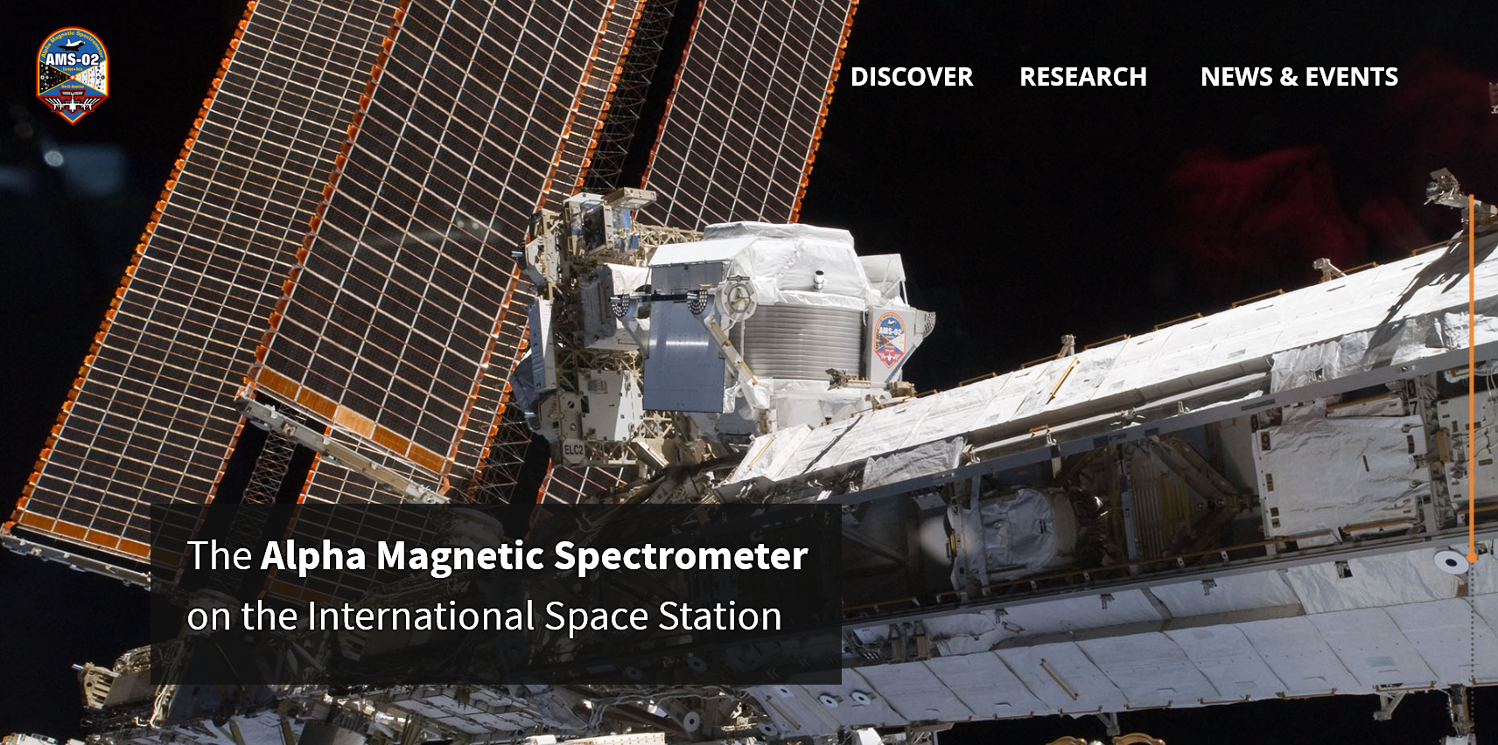
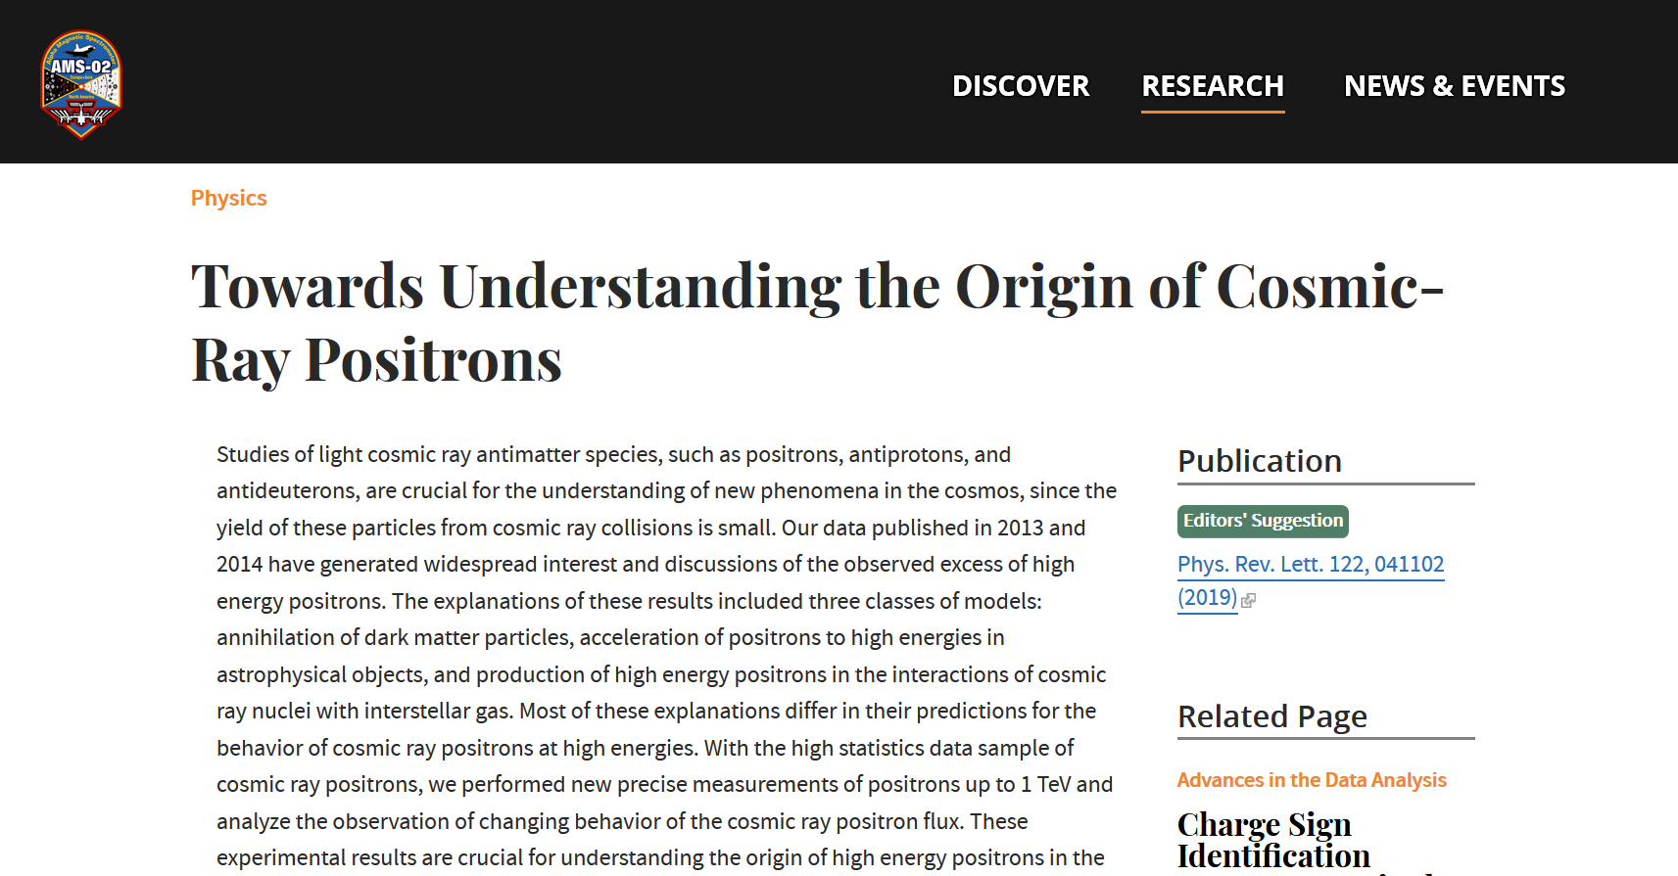

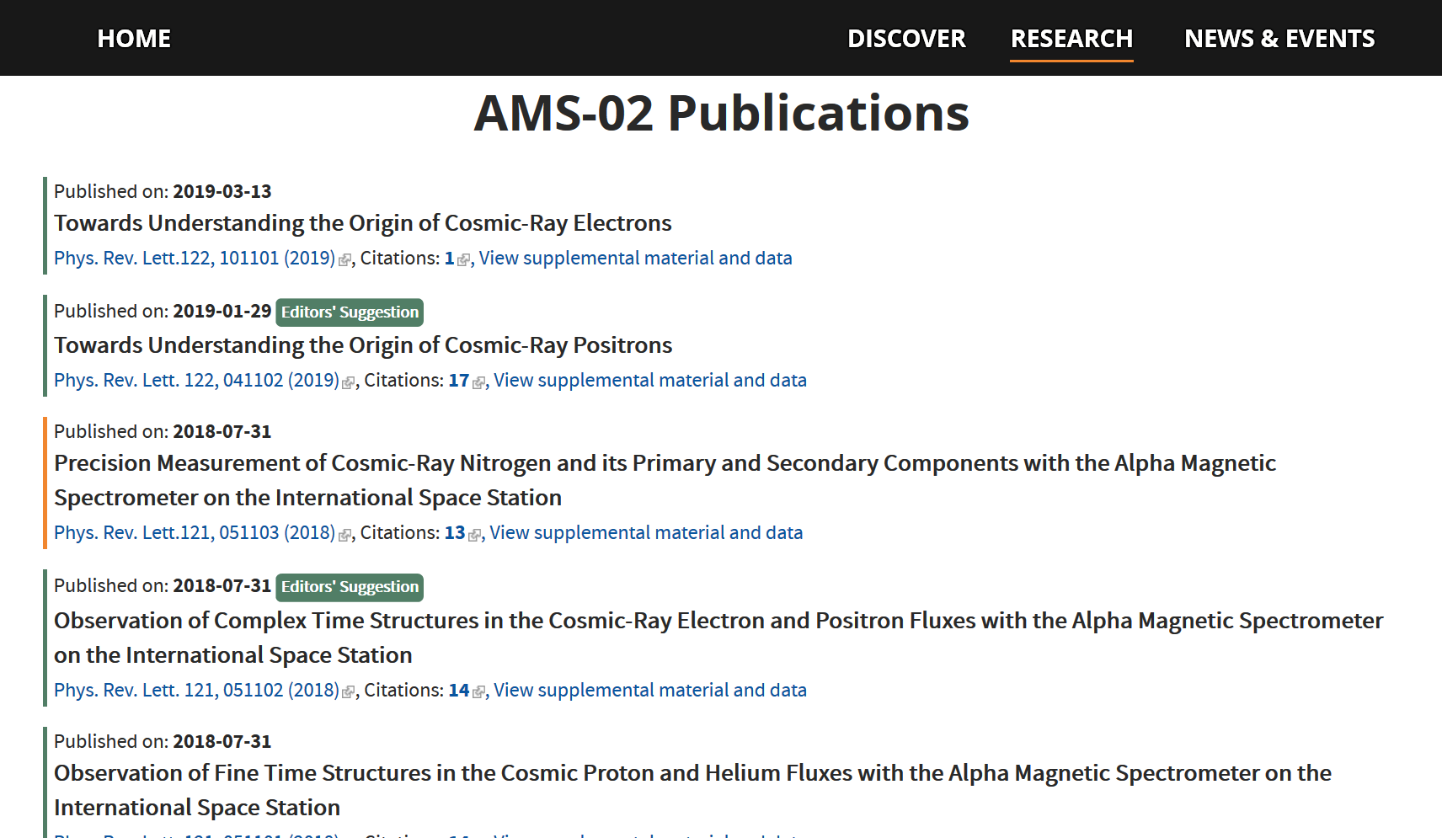
Please visit:
https://AMS02.space
for details about our
detector
analysis
physics results
and more

Slide 3
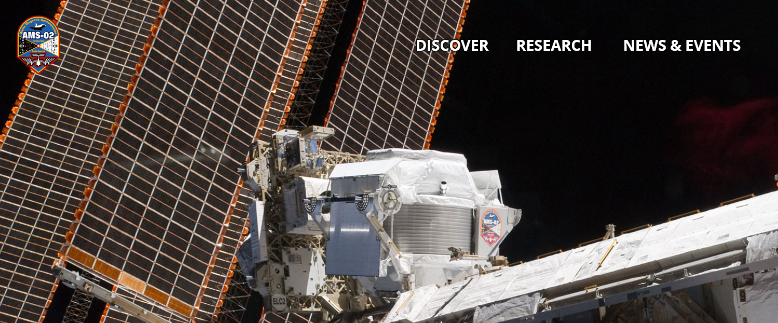
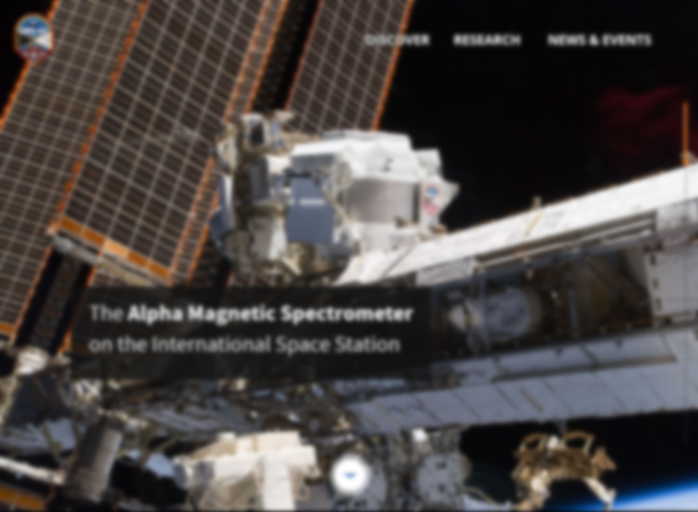

Please visit
For more details about our detector, analysis, and physics results
https://AMS02.space

Slide 4
Please visit
For more details about our detector, analysis, and physics results
https://AMS02.space

Slide 5

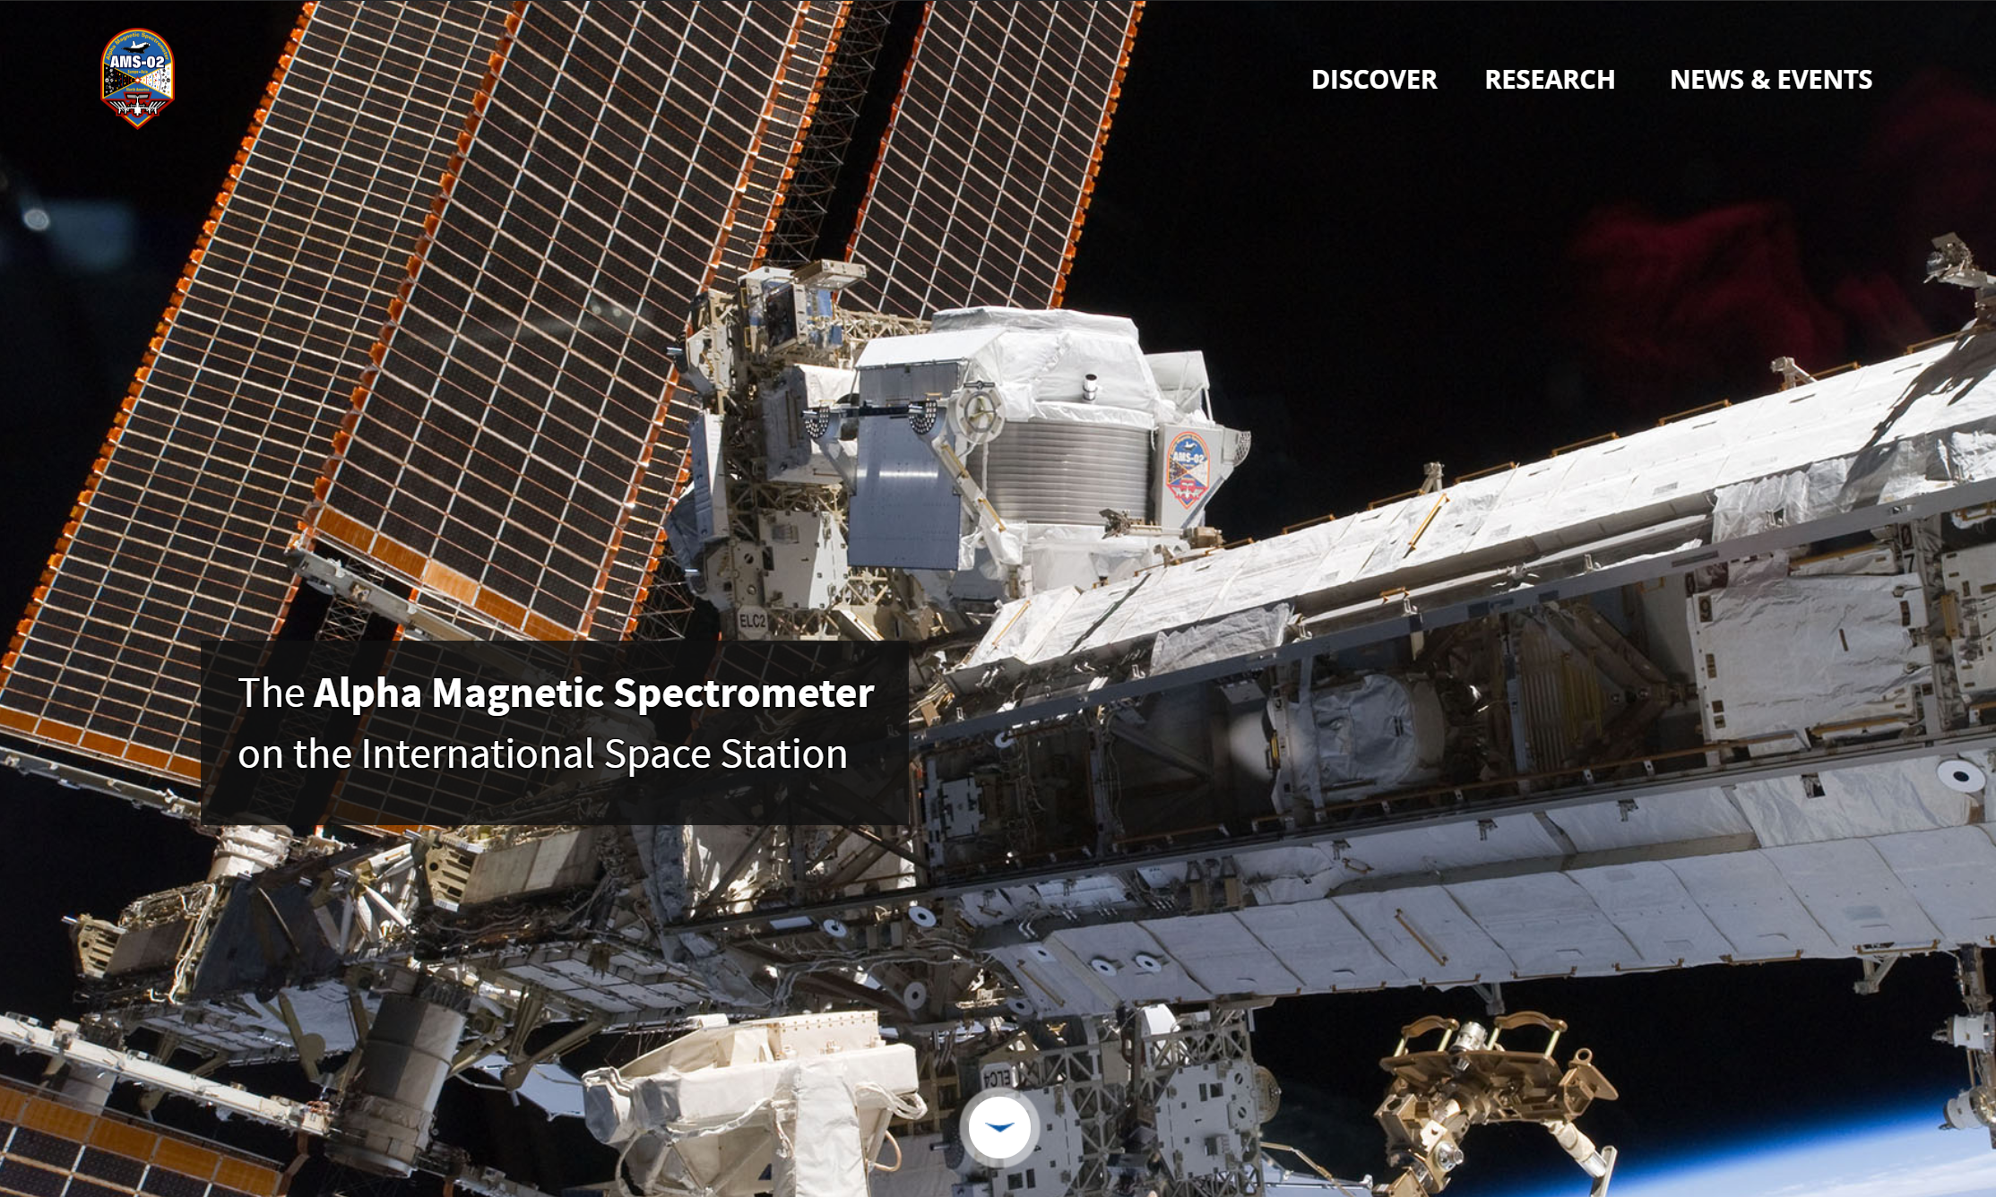
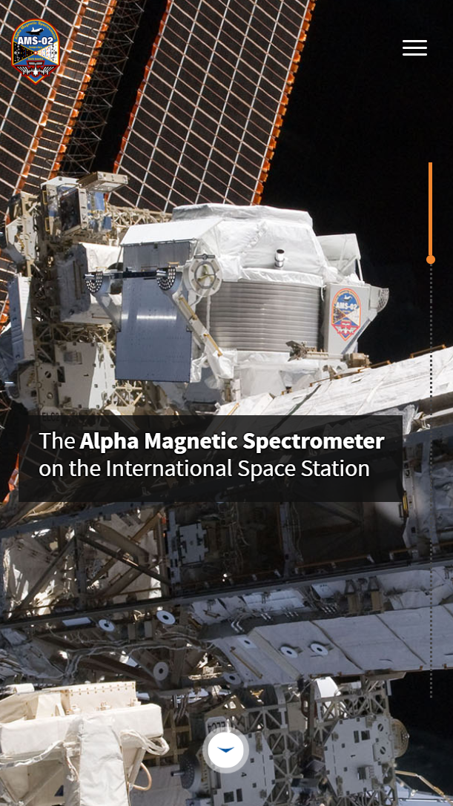
https://AMS02.space
For more details about our detector, analysis, and physics results

Slide 6


https://AMS02.space
For more details about our detector, analysis, and physics results

